Slide 1

Simulation and Analysis of a Bidirectional AC-DC and DC/DC Converters for Vehicle-to-Grid (V2G) Applications
Afaf Allabadi, Chenyi Xu, David Zhang

Slide 2
Introduction

Slide 3
Introduction
Increased popularity of EVs
V2G/G2V Technology
a Bidirectional AC-DC and a DC/DC Converter for V2G
Benefits
PHEVs in Action

Slide 4
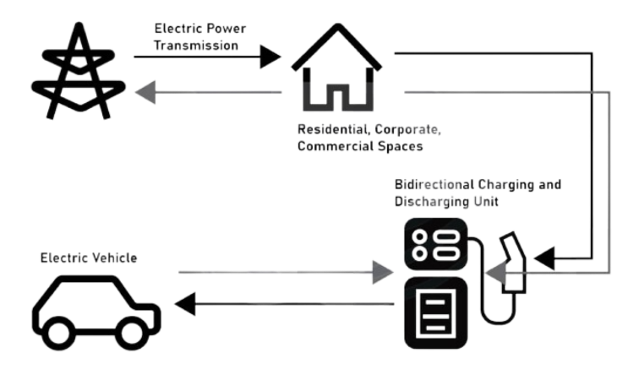
Bidirectional Energy Flow System
The converters manage seamless energy transfers between vehicles and the grid, ensuring optimal stored energy utilization.

Slide 5
Principle of Operation

Slide 6
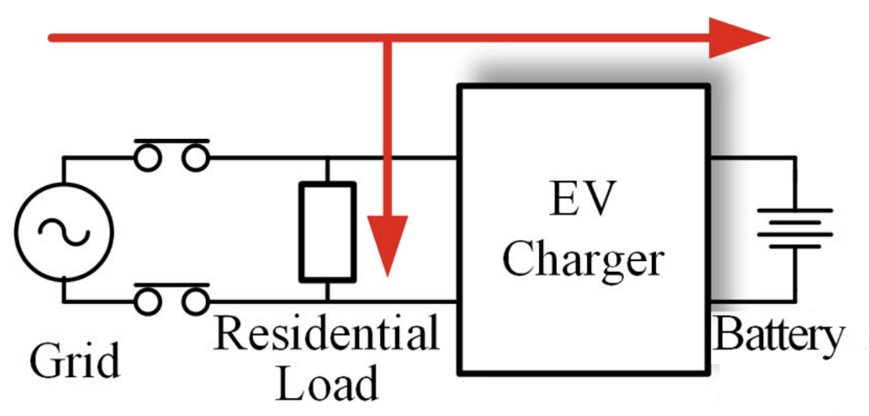
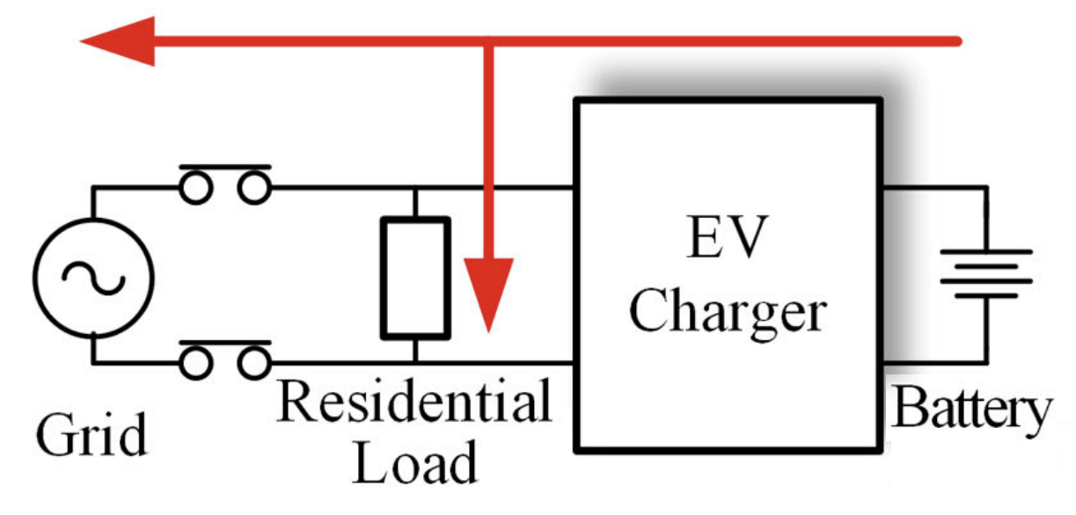
Principle of Operation
This system employs a bidirectional DC-DC buck-boost converter, which operates in buck mode during charging (G2V) to step down the DC bus voltage to the battery level and in boost mode during discharging (V2G) to step up the battery voltage for grid integration.
G2V mode
V2G mode

Slide 7
Operation Modes
Buck Mode
Boost Mode
G2V mode
V2G mode

Slide 8
System Configuration

Slide 9
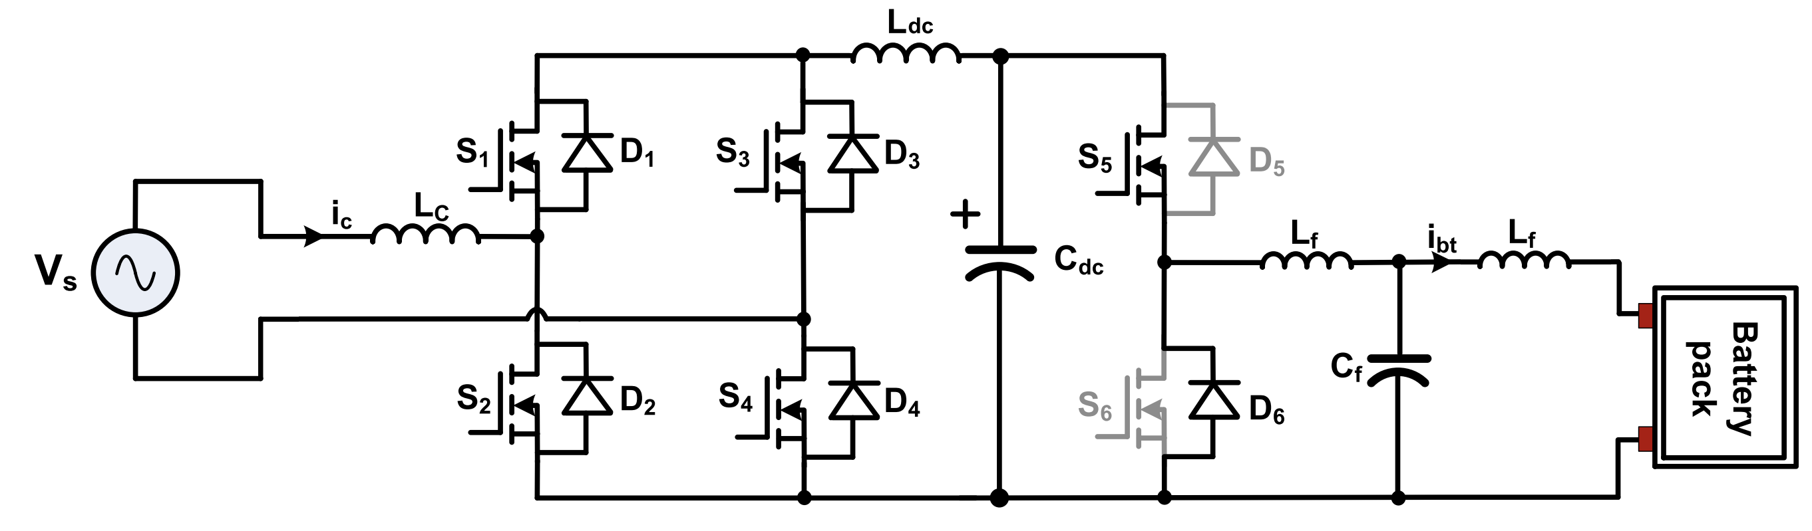
System Setup
The system consists of two main stages: a single-phase bidirectional AC-DC converter and a bidirectional buck-boost DC-DC converter.

Slide 10
System Setup
In the first stage:
a 230 V, 60 Hz AC supply is converted to 380 V DC using a single-phase bidirectional AC-DC converter.
The AC-DC converter employs an LCL filter at its output to reduce high-frequency harmonics and ensure smooth DC voltage.
This filter combines inductors and a capacitor to improve power quality by mitigating ripple currents and voltage distortions caused by the switching actions of the converter.

Slide 11
System Setup
In the second stage:
a bidirectional buck-boost DC-DC converter manages the charging and discharging of the EV battery.
A low-pass filter is integrated at the output of the DC-DC converter to stabilize the voltage and minimize current ripples, ensuring efficient and safe energy transfer.

Slide 12
System Setup
The battery, rated at 1.2 kW charging power and 120 V, is modeled as part of a PHEV

Slide 13
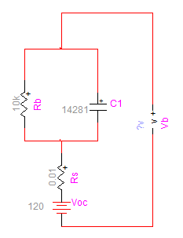

Storage Battery
The battery is modeled using Thevenin’s equivalent circuit.
$$C_{1}:parallel capacitor$$
$R_{b}:$ parallel resistance
$R_{S}:$internal resistance
$V_{oc}:$ open circuit voltage

Slide 14
System Design

Slide 15
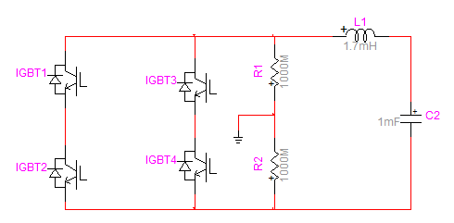
AC/DC Converter
The AC/DC converter converts AC grid power (230 V, 60 Hz) into DC power (380 V) for charging the EV battery by generating appropriate switching pulses for the converter's operation.

Slide 16

AC/DC Converter
The filter is designed to ensure system stability, minimize harmonic distortion, and smooth power flow, by using:
$C_{dc} =\frac{P}{2πfV_{dc} ΔV_{dc}}$
$L_{g}=\frac{V_{g}}{4f_{s}ΔI}$
$L_{c}=\frac{V_{dc}}{4f_{s}ΔI_{c}}$

Slide 17
DC/DC Bidirectional Converter
The DC-DC converter regulates the voltage between the DC bus (380 V) and the battery (120 V) to facilitate efficient energy transfer during both charging and discharging modes. It utilizes two switches: K1 operates in buck mode, while K2 operates in boost mode.

Slide 18


DC/DC Bidirectional Converter control
The control strategy for the converter is based on a PI controller that controls the battery output current (I_{b}). The measured battery current is compared with the reference current (I_{b,ref}), and the PI controller generates the control voltage signal (V_{ref}) by utilizing the current error
$$I_{e}=I_{b,ref}−I_{b}$$
$$V_{ref}=V\left(t−1\right)+K_{p}\left(I_{e}\left(t\right)−I_{e}\left(t−1\right)\right) +K_{i}I_{e}\left(t\right)$$
Where K_{p} and K_{i} are the proportional and integral gains of the voltage control. The PI controller is designed by employing the Ziegler-Nichols method to ensure a stable and fine-tuned design system.

Slide 19
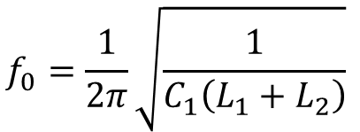
DC/DC Bidirectional Converter
An LCL filter is integrated at the output of the DC/DC converter to reduce high-frequency switching noise and smooth the output current.
The filter's total impedance is optimized for stability and low THD, with resonance frequency calculated as:
$$\begin{aligned}f_{0}=\frac{1}{2π}\sqrt{\frac{1}{C_{1}\left(L_{1}+L_{2}\right)}} \end{aligned}$$

Slide 20

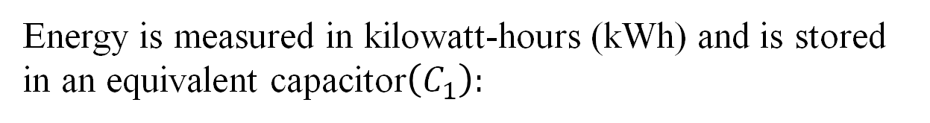
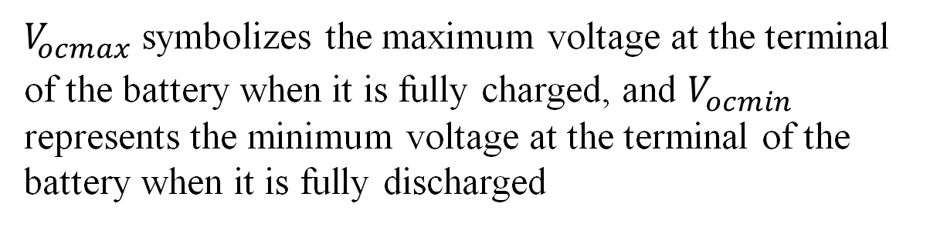
Storage Battery
Energy is measured in kilowatt-hours (kWh) and is stored in an equivalent capacitor$\left(C_{1}\right):$
$C_{bb} =\frac{(kWh ∙3600 ∙1000)}{0.5 (V_{ocmax}^{2}− V_{ocmin}^{2})}$
$V_{ocmax}$ symbolizes the maximum voltage at the terminal of the battery when it is fully charged, and $V_{ocmin}$ represents the minimum voltage at the terminal of the battery when it is fully discharged

Slide 21
Simulation and Performance Evaluation

Slide 22
Overview of the Simulation
An ideal source models the grid
The converters are modeled with an IGBT with an antiparallel diode
AC-DC converter
DC-DC converter
Battery model
Grid

Slide 23
The control of bidirectional DC-DC converter
Error signal

Slide 24
Simulation Parameters
Parameter |  | value
DC-DC converter | Switching frequency | 5 kHz
 | PI Controller Gains - Kp | 0.001
 | PI Controller Gains - Ki | 6
 | Output current | 10 A
 | First Filter inductance | 2 mH
 | Filter capacitance | 1 mF
 | Second filter capacitance | 6 mH
Storage Battery | Rb | 10kΩ
 | Cb | 0.14282 F
 | Rs | 0.01 Ω
 | Open circuit voltage | 120 V
Parameter |  | value
AC-DC converter | Grid AC voltage | 230 V
 | Output DC voltage | 380 V
 | Grid frequency | 60 Hz
 | Line-side inductor | 300 mH
 | Filter inductance | 2.1 mH
 | Filter capacitance | 200 mF

Slide 25
Simulation Validation
The simulation was performed over 1 second, where the converter operated in charging mode for the first 0.5 seconds and switched to discharging mode for the remaining 0.5 seconds.

Slide 26
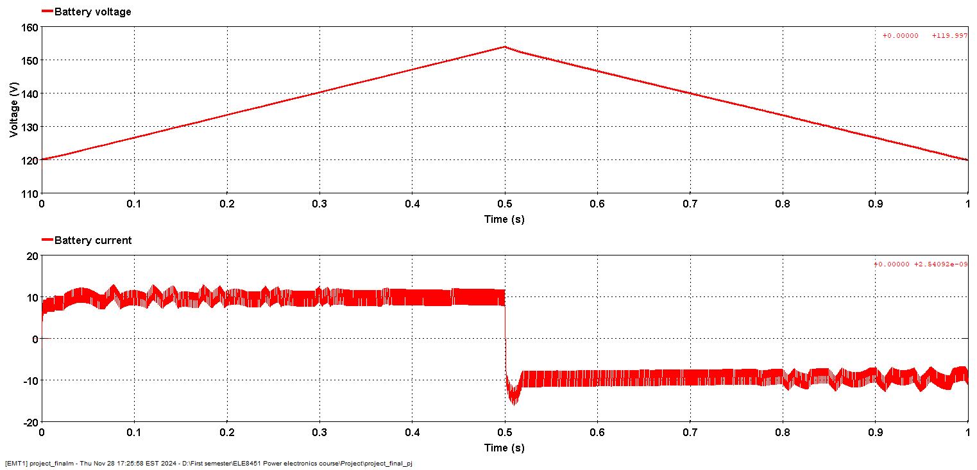
Simulation Validation
In the charging phase: the battery voltage increased steadily as it received energy from the grid. The battery current followed the reference signal.
In the discharging phase: the current reversed direction, supplying power back to the grid. The battery voltage decreased during energy discharge.

Slide 27
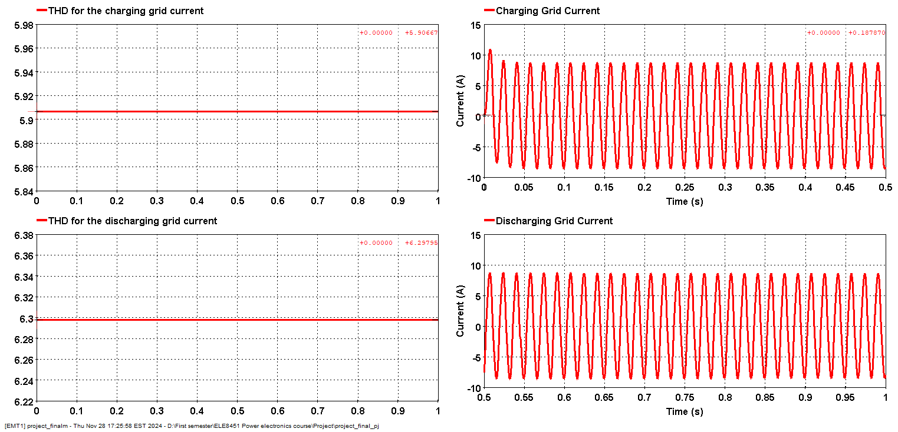
Simulation Validation
The current waveform in the grid was sinusoidal and balanced in both modes. The THD measurements during charging and discharging modes were relatively low.

Slide 28
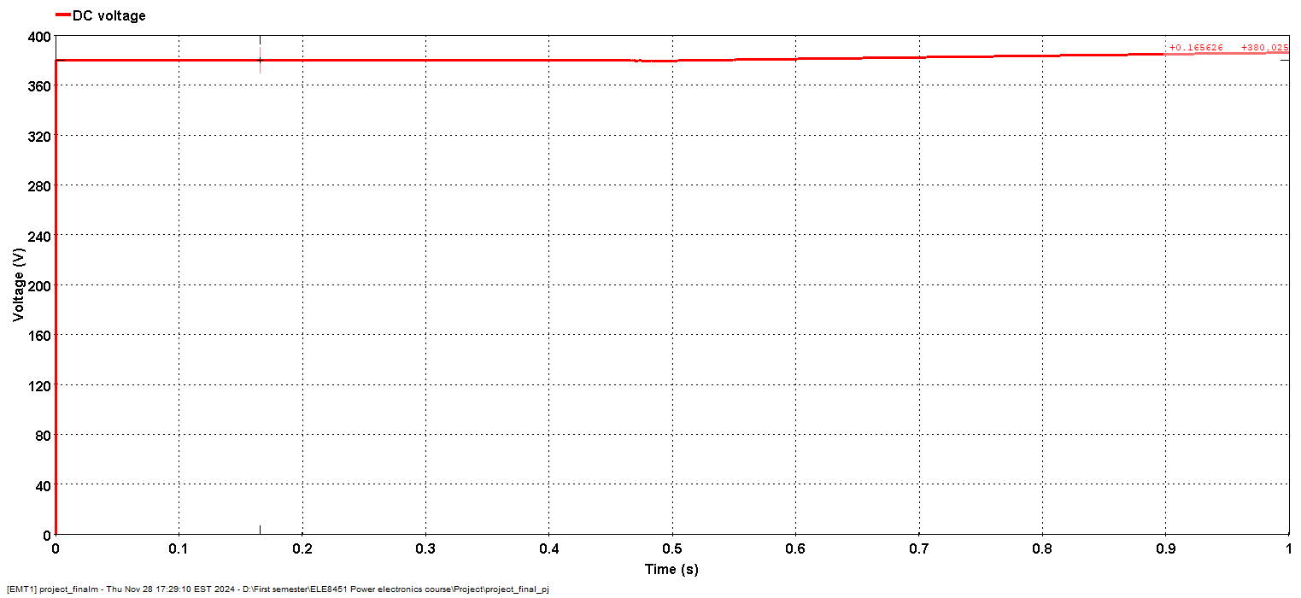
Simulation Validation
The DC bus voltage remained stable throughout the simulation.

Slide 29

Questions?

Slide 30
Thank you!

